Slide 1
Human Detector
Motions? Movements?

Slide 2
Why do we need it?
Detecting motions or movements has always been important in most projects. With the help of the PIR Sensor it has become very easy to detect human/animal movements.
In this project we will learn how we can interface a PIR Sensor with a microcontroller like Arduino. We will interface an Arduino with PIR module and blink a LED and beep a Buzzer whenever a movement is detected
Crimes? Robberies? Comparatively less.

Slide 3
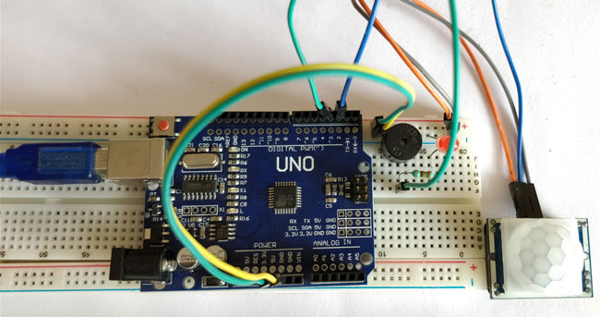
The Human Detector

Slide 4
Materials required
PIR Sensor Module
Arduino UNO (any version)
LED
Buzzer
Breadboard
Connecting Wires
330 ohm resistor

Slide 5
Cost estimation
PIR Sensor Module -
Arduino UNO (any version) -
LED -
Buzzer -
Breadboard -
Connecting Wires -
330 ohm resistor -

Slide 6
Working
The circuit and program for this Arduino motion detector project is already discussed above..
Now, power on the Arduino and wait for about 50-60 seconds for your PIR sensor to calibrate. After that, try moving in front of the PIR sensor and LED/Buzzer should be triggered
The beeping/flashing should stop after some time; you can now toy around the output by varying the potentiometer to change the sensitivity or the low time of the module.

Slide 7
Advantages
Can be used in AI
Can be used for security purposes
Can be used for controlling traffic
Can be used to maintain security at airports

Slide 8
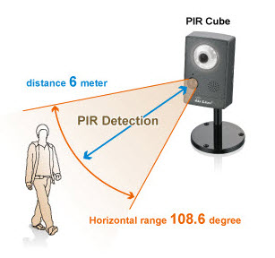
Applications
Security Alarm System based on PIR sensor
PIR Sensor based Automatic Door Opening System
Human Detection Robot Using PIR Sensor
PIR Sensor based Stepper Motor Control
PIR Sensor Based Projects with Abstracts
PIR Sensor based Stepper Motor Control

